Slide 1
Data Analytics Pipeline
Week Two: Data is valuable

Slide 2
An example

Slide 3
MAYOR AND CITY COUNCIL LAUNCH SEARCHABLE OPEN BUDGET FOR NEW YORK CITY
Notes:
We have a new data source!!

Slide 4
“NYC has entombed this data in PDFs for years, making it basically impossible to analyze and understand what is going on. But for the first time, we can actually do things like look at the top spending for each agency...”
Notes:
It’s not that the data didn’t exist, or wasn’t available before. It was a *change of format* that made the difference. Many companies still rely on old, hard to read and process formats for their data. E.g. monolithic excel sheets instead of databases

Slide 5
“The bad news in all of this is that the City only put this year’s budget (FY2017) on the Open Data portal and left all prior years off. This makes it impossible to look for trends and year-to-year changes”
Notes:
Not everything you’d want is there, but there’s some good stuff. No time-series analysis is possible with this data.

Slide 6
It categorizes expenses all the way down to the “Object Code” Name. Object Codes include everything from “Full Time Position” costs and “Overtime” to “Postage” and “Telephone Services.” Each Object Code is assigned to an Agency, so you can track the expenses from each agency.

Slide 7
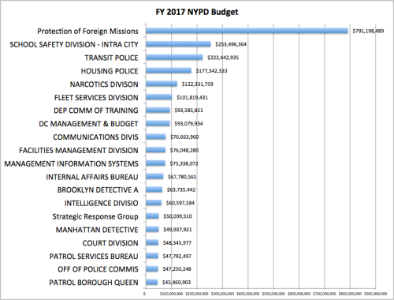
Notice something weird?

Slide 8
It’s a typo!
“In a 2012 statement, Ray Kelly pegged the amount budgeted for the protection of foreign missions at $27 million. A 30 times increase since then would seem nearly impossible.”

Slide 9
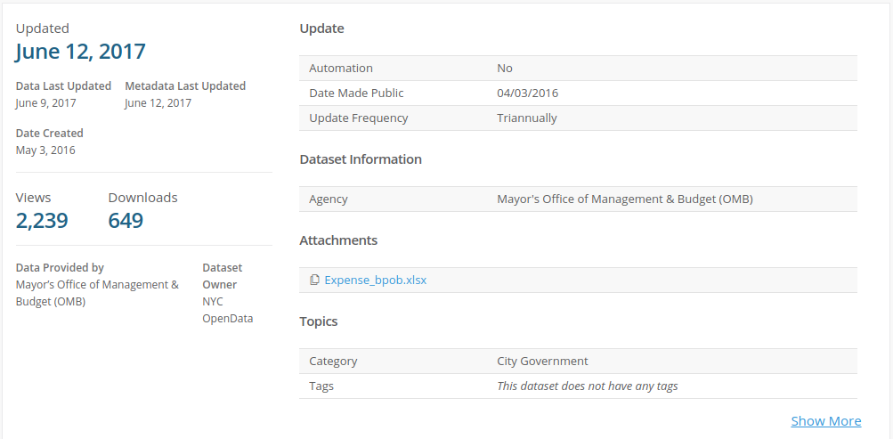
Let’s try re-creating the result!
Notes:
https://data.cityofnewyork.us/City-Government/Expense-Budget/mwzb-yiwb

Slide 10
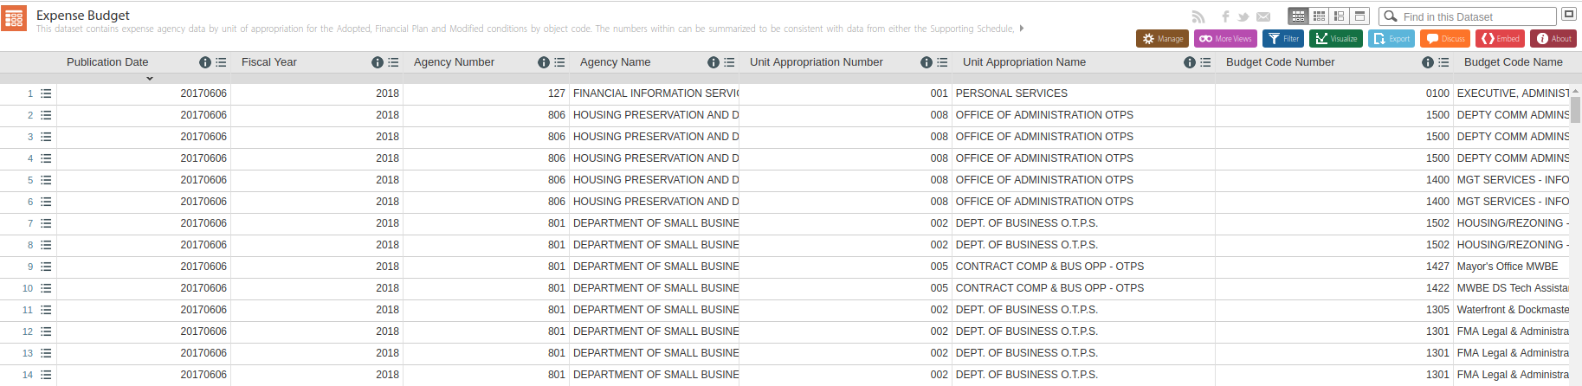

Slide 11
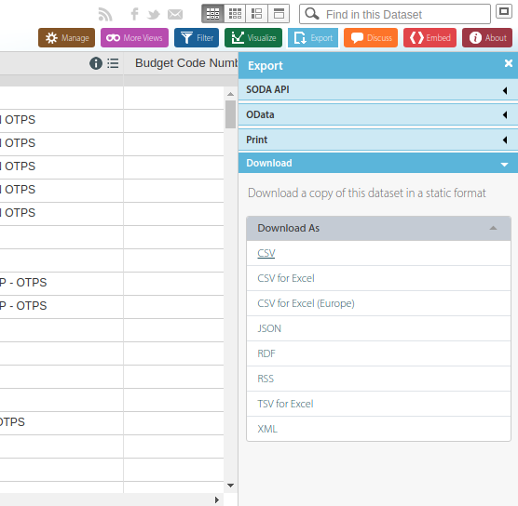
Get data here!

Slide 12
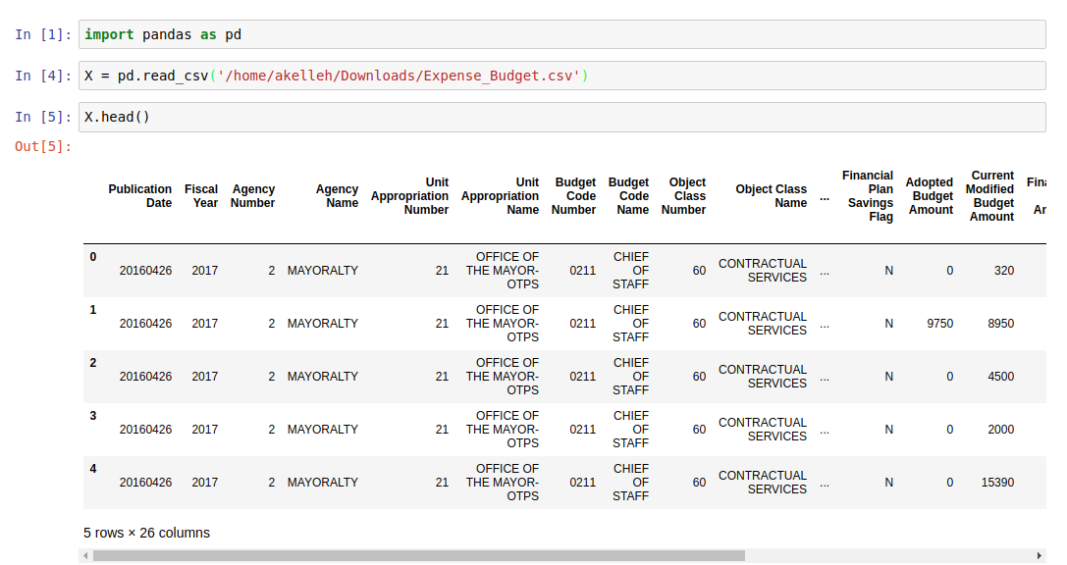
Import the data

Slide 13
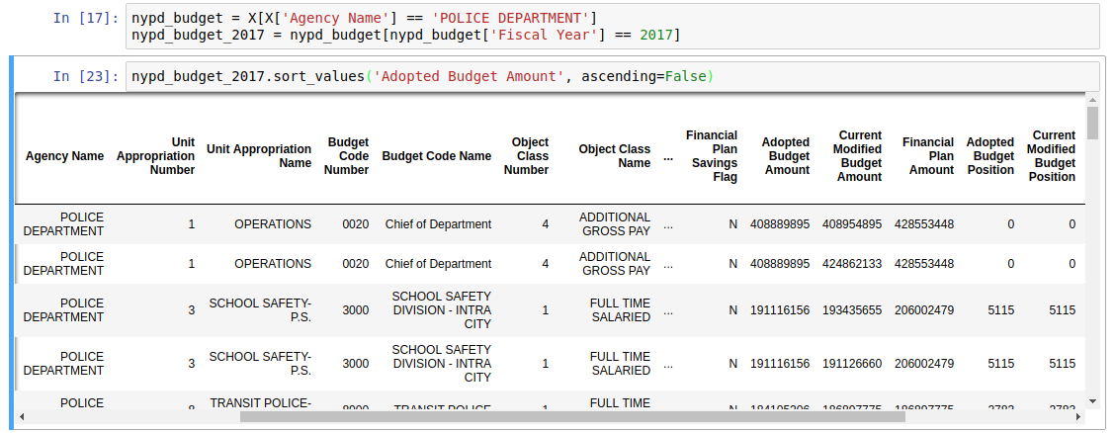
They fixed it!

Slide 14
In general:
There are many causes for the value of a variable
Extreme cases sometimes have a single cause that’s easy to identify

Slide 15
What happens when the values are noisy?
If there are a few extreme values, a little noise has no change in the ranking
If the noise is comparable in magnitude to the distance between list items, there is some re-ranking
If the noise is large compared to the distance between items, there is a lot of re-ranking

Slide 16
Does this ranking tell you anything?
item | clicks | impressions | click rate
1 | 5 | 10 | 0.5
2 | 2000 | 10000 | 0.2
3 | 1 | 10 | 0.1
Notes:
Display ads are around 0.5%!

Slide 17
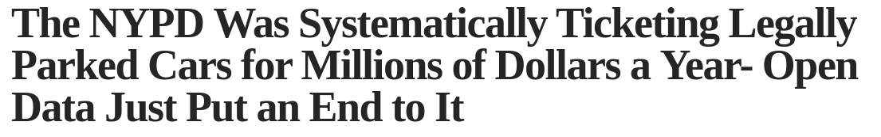
Another quick example:

Slide 18
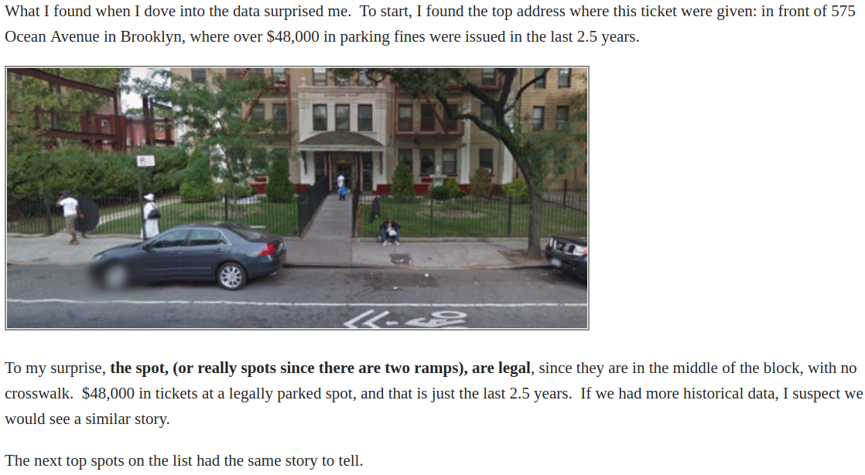

Slide 19
Again, extreme values have a clear cause
People parked in legal spots
The laws regulating those spots were unclear
People received tickets

Slide 20
Generally, we look at statistics, and not just raw data
Which statistics?!

Slide 21
We can go beyond raw data, to KPIs
KPI: key performance indicator
Example: “The conversion rate of an e-commerce site is the percentage of visits to the website that include a purchase.”
Quotes and examples from Kohavi et al

Slide 22
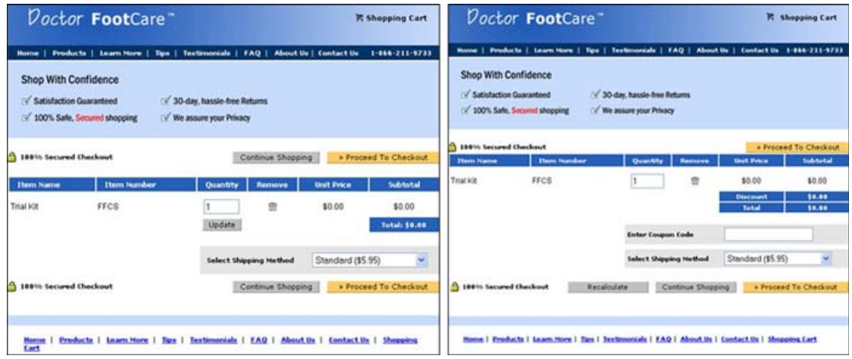
Example 1: Which is better?

Slide 23
Results:
Variant A [left] outperformed variant B [right] by an order of magnitude. In reality, the site “upgraded” from the A to B and lost 90% of their revenue!
Most of the changes in the upgrade were positive, but the coupon code was the critical one: people started to think twice about whether they were paying too much because there are discount coupons out there that they do not have.

Slide 24
Example 2: Office Help Ratings
Users of Microsoft Office who request help are given an opportunity to rate the articles they read. The initial implementation presented users with a Yes/No widget. The team then modified the widget and offered a 5-star ratings.

Slide 25
Why?
The 5-star widget provides finer-grained feedback, which might help better evaluate content writers.
The 5-star widget improves usability by exposing users to a single feedback box as opposed to two separate pop-ups (one for Yes/No and another for Why)
Guess what happened!

Slide 26
Results:
“[the] number of ratings plummeted by about 90%”
“it turned out that the two-stage model helps in increasing the response rate”
“people chose the extremes (one or five stars)”

Slide 27
Example 3: How many ads?
“In the short-term, increasing the real-estate given to ads can increase revenue”
“what will it do to the user experience, especially if these are non-targeted ads?”

Slide 28
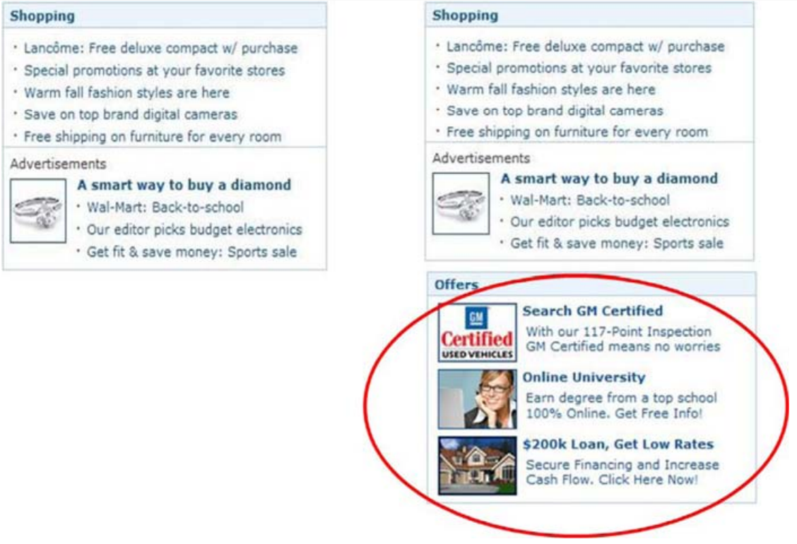
Proposal

Slide 29
“The interesting challenge here is how to compare the ad revenue with the “user experience.” “

Slide 30
Home page views generate values directly, by allowing to serve ad impressions
Clicks out from the home page have value as well. The value was estimated as the cost of generating that traffic by other means (e.g. search engine marketing)

Slide 31
Results:
“A controlled experiment was run on 5% of the MSN US home page users for 12 days. Clickthrough rate decreased by 0.38% (relative change), and the result was statistically significant (p-value = 0.02).”
“Translating the lost clicks to their monetary value, it was higher than the expected ad revenue, so the idea of adding more ads to the MSN home page was scrapped.”

Slide 32
Notice:
In many of these examples, there was a rate which was the important quantity (e.g. conversion rate, response rate).
In some examples, the important quantity was a total (e.g. total revenue, total responses)

Slide 33
Defining the right quantities is hard
In the previous examples, we were just ranking raw data points on an interesting value
How do you define good statistics?
This section based on the HBR article by Kalyan Veeramachaneni

Slide 34
“... whenever we spoke with machine learning experts (data scientists focused on training and testing predictive models) about the most difficult part of their job, they said again and again, “the data is a mess.””
“In its rawest form, even clean data is too overwhelming and complex to be understood at first glance, even by experts. It has too many tables and fields and is often collected at a very high granularity (for example, online clickstreams generate new data with every click, and sensor data is collected at 125 observations per second).”

Slide 35
“If companies want to get value from their data, they need to focus on accelerating human understanding of data, scaling the number of modeling questions they can ask of that data in a short amount of time, and assessing their implications.”
Stick with simple models
Explore more problems
Learn from a sample of data—not all the data
Focus on automation

Slide 36
Main Takeaways:
Focus on “low-hanging fruit”
Make data available to more people to generate more value
Automate data analysis processes

Slide 37
What tools can we use to do these things?

Slide 38
Pandas
DataFrames are the basic data structure, which you can think of as a database table, or an excel sheet.
Series are within a DataFrame, and represent the columns.
Series can stand alone, and be indexed. These are good for representing time-series data.

Slide 39
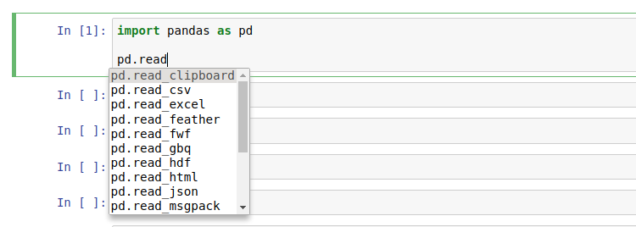
Read in data

Slide 40
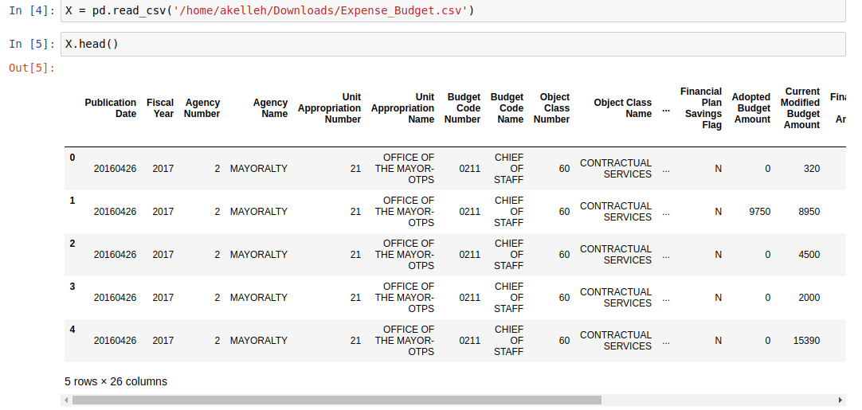

Slide 41
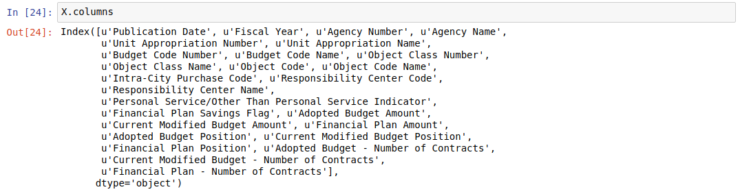
Accessing data -- what is in the DataFrame?

Slide 42
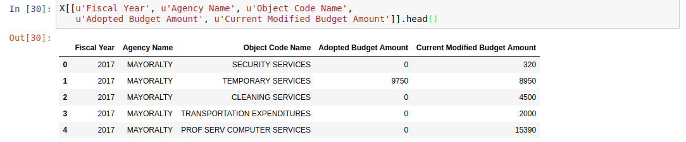
Accessing Data -- Choosing a selection of columns

Slide 43
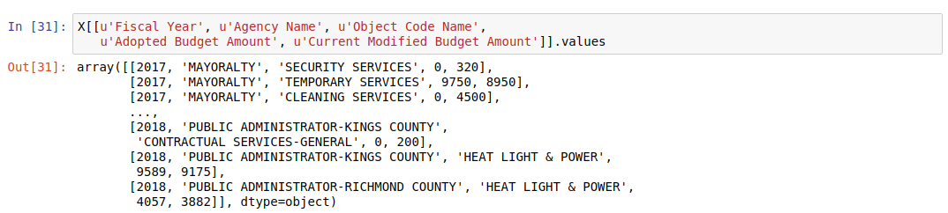
Accessing data -- The underlying data structure

Slide 44
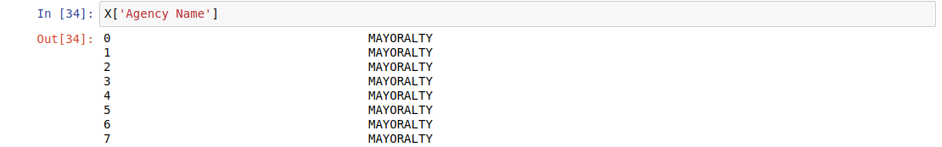
Accessing Data -- Columns as Series
Prints the index (on the left) and the values (on the right)

Slide 45
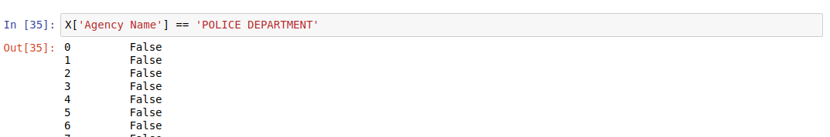
Logic with Series

Slide 46
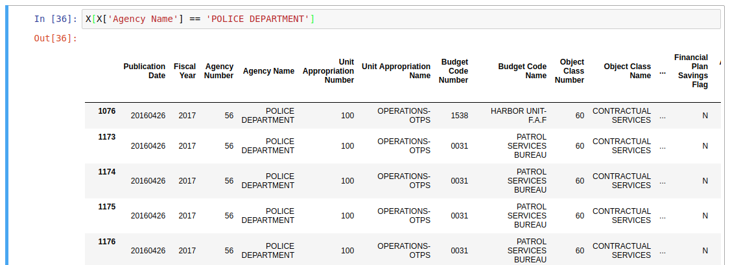
Masking DataFrames with indexed series

Slide 47
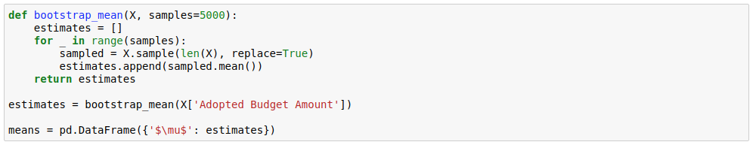
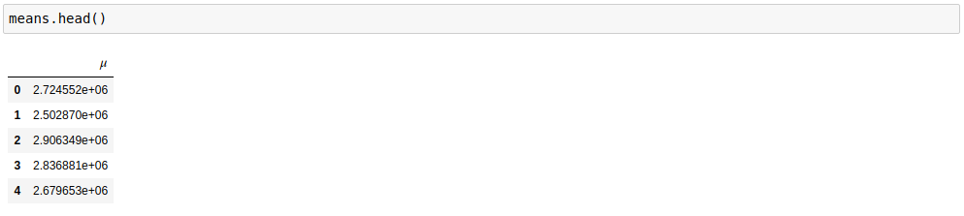
Example: bootstrap confidence bounds

Slide 48
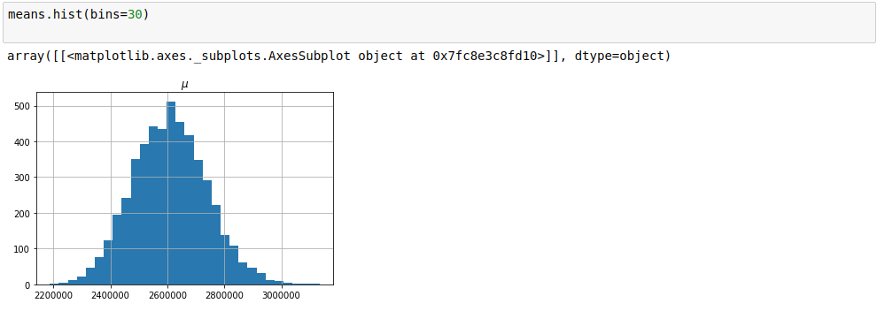
The sampling distribution (estimate)

Slide 49
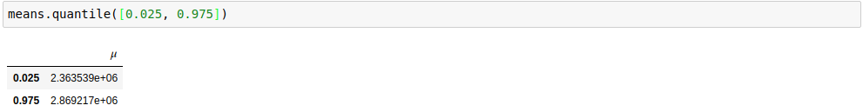
Approximate confidence bounds

Slide 50
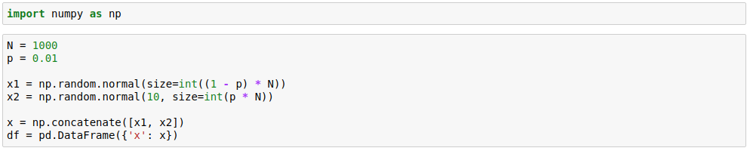
Robustness
Consider a mixture...

Slide 51
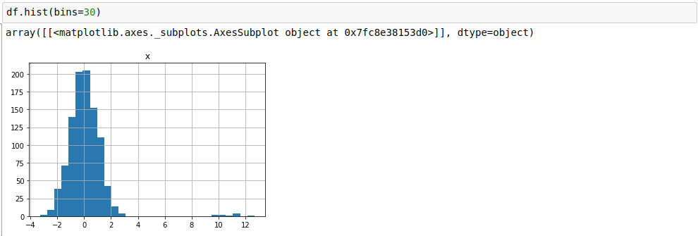
A small portion of data is outliers

Slide 52
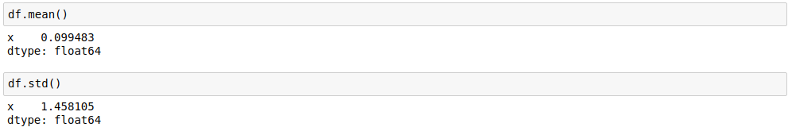
Sensitivity:
Normally, std dev= 1.
1% of data points lead to a 45% increase in std dev!

Slide 53
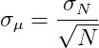
The normal approximation
To estimate error in a sample mean, for large enough samples, you can use a normal approximation
45% increase in means a 45% increase in our mean estimate’s error!

Slide 54
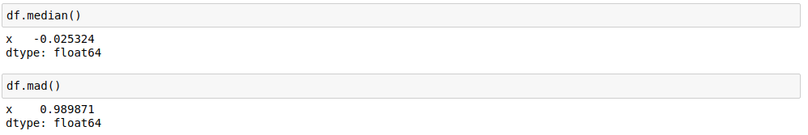
The Median and MAD are robust to this!
2.5% error for the median
1.1% error for the MAD

Slide 55
Takeaway:
It can be hard to get good measurements for averages
Consider the median
Aim for low variance metrics
This problem is general, and applies to regression models as well.

Slide 56
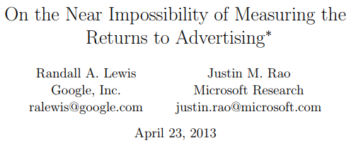
Example:
Ad ad generates an expected sales of $0.35 per view
Most people don’t make a purchase, so the average sale is $7 with a standard deviation of $75
The R² = 0.0000054 -- tiny effect!! Sample selection effects can easily overwhelm it

Slide 57
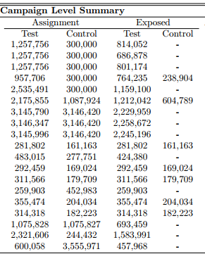
Result:
Need much larger sample sizes:
“Only 3 of the 25 campaigns could reliably distinguish between a wildly successful campaign (+50% ROI) from one that broke even (0% ROI); the median campaign would have to be 9 times larger”
But these were web-scale studies!
Choose a better statistic

Slide 58
Rates
You can choose better KPIs!
Consider a conversion “funnel”
User visits site
User adds item to “cart”
User initiates “checkout”
User completes “checkout” (so you gain revenue)
Usually:
0.5 > P(visits) > P(adds item) > P(starts checkout) > P(completes checkout)

Slide 59
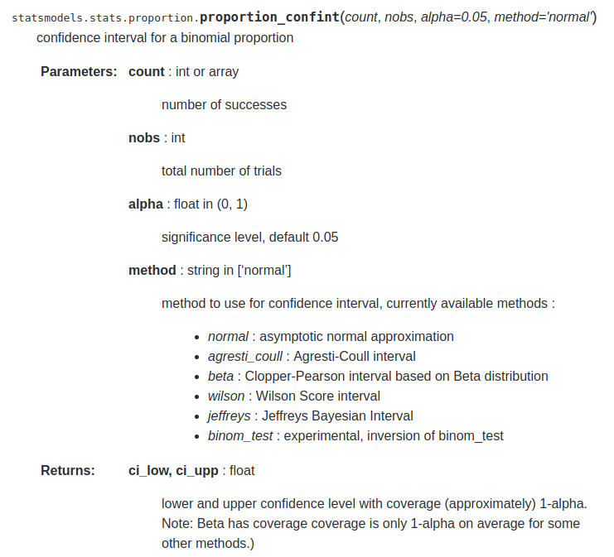
statsmodels

Slide 60
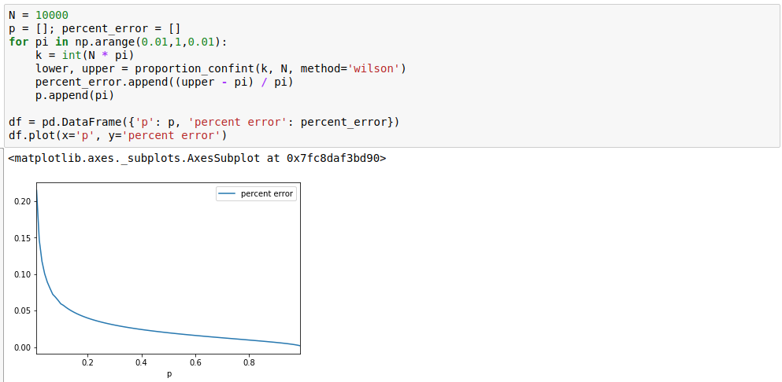
How do confidence intervals behave as rates decrease?
As p increases, we have more successes
As p increases, the denominator increases, too
How confident are we in the failure rate at high p?

Slide 61
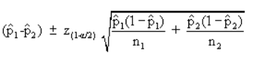
Binomial proportion differences

Slide 62
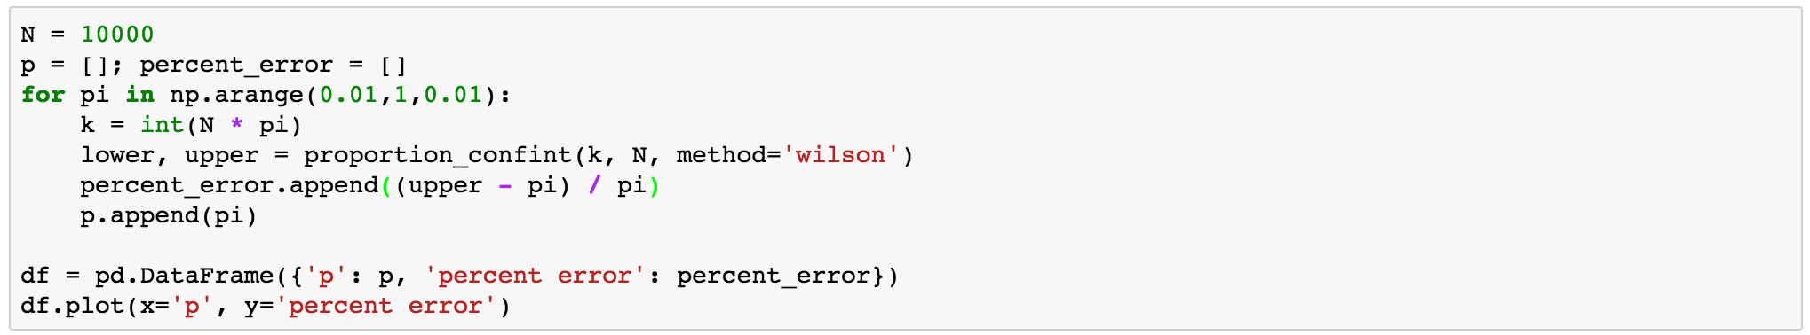
Calculate some relative error at different success rates

Slide 63
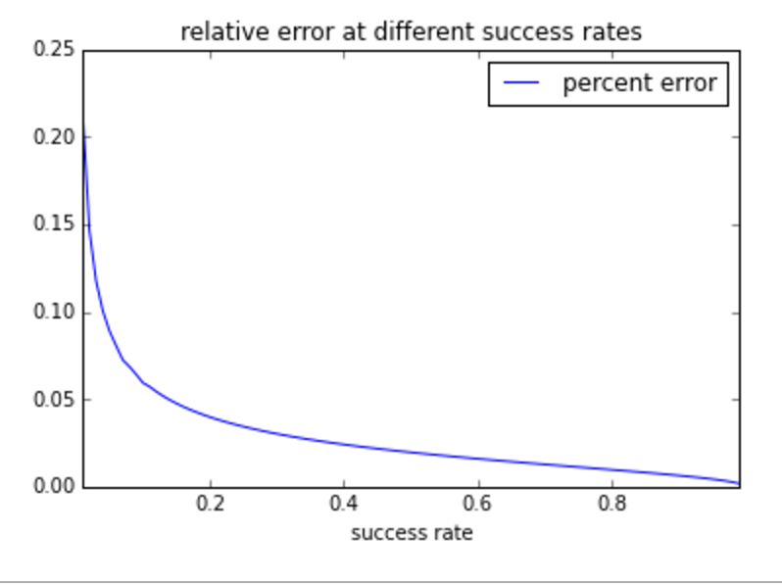
Lower success rate = high relative error!

Slide 64
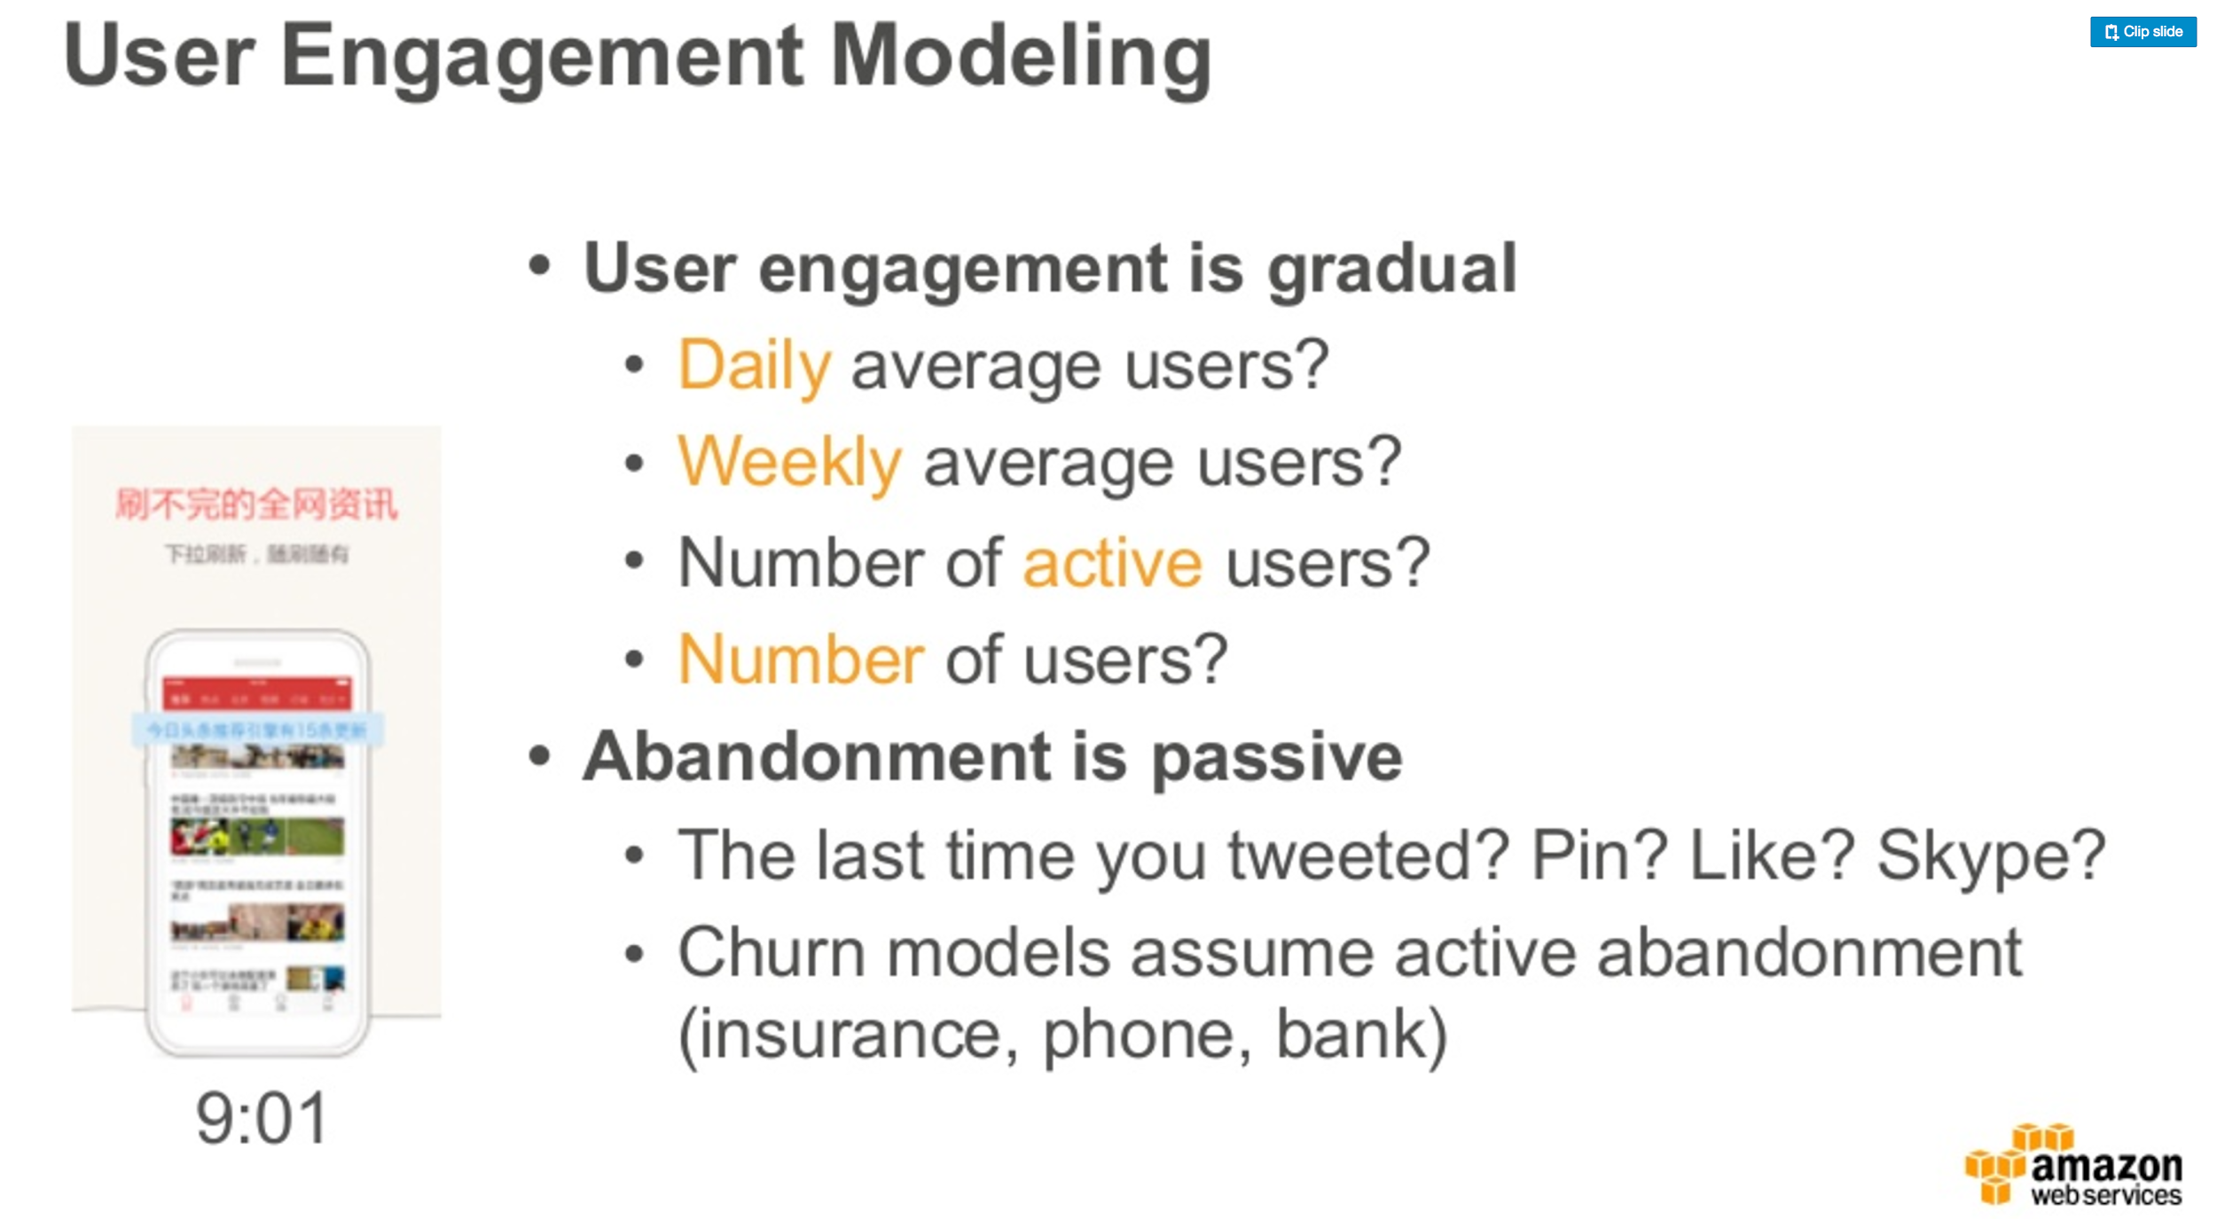
Survival analysis
Credit: Alex Smola
Notes:
https://www.slideshare.net/SessionsEvents/alex-smola-director-of-machine-learning-awsamazon-at-mlconf-sf-2016

Slide 65
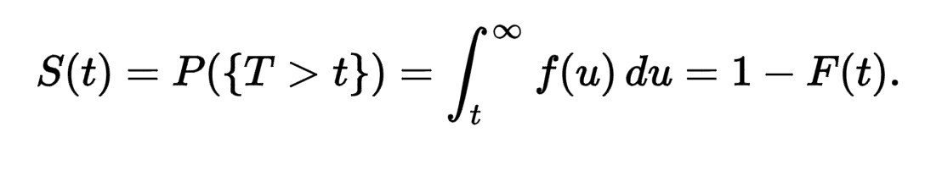
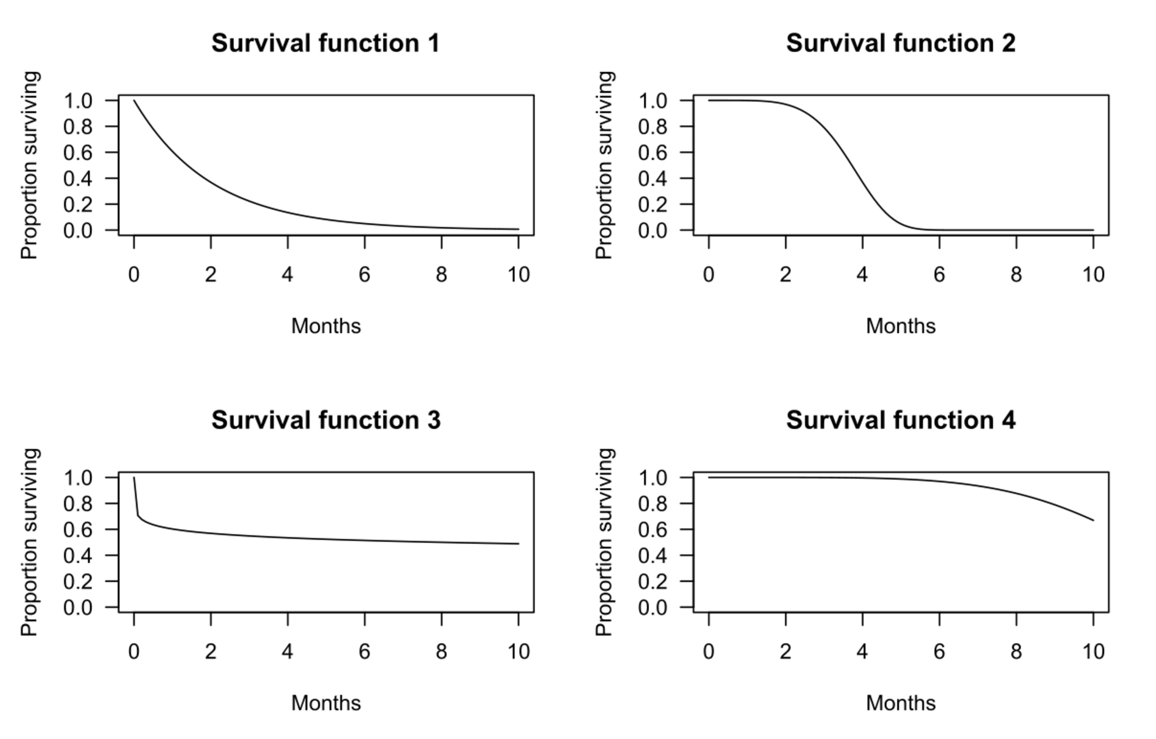
Survival Plots

Slide 66
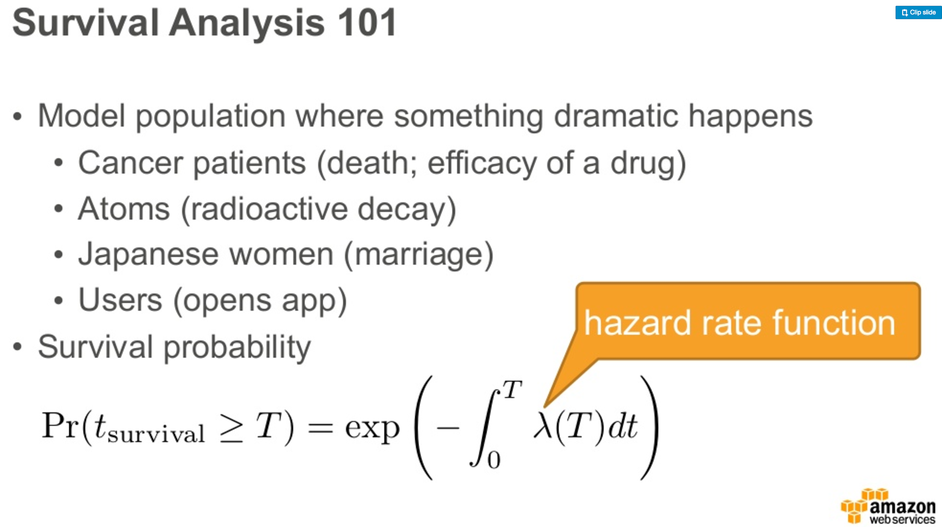

Slide 67
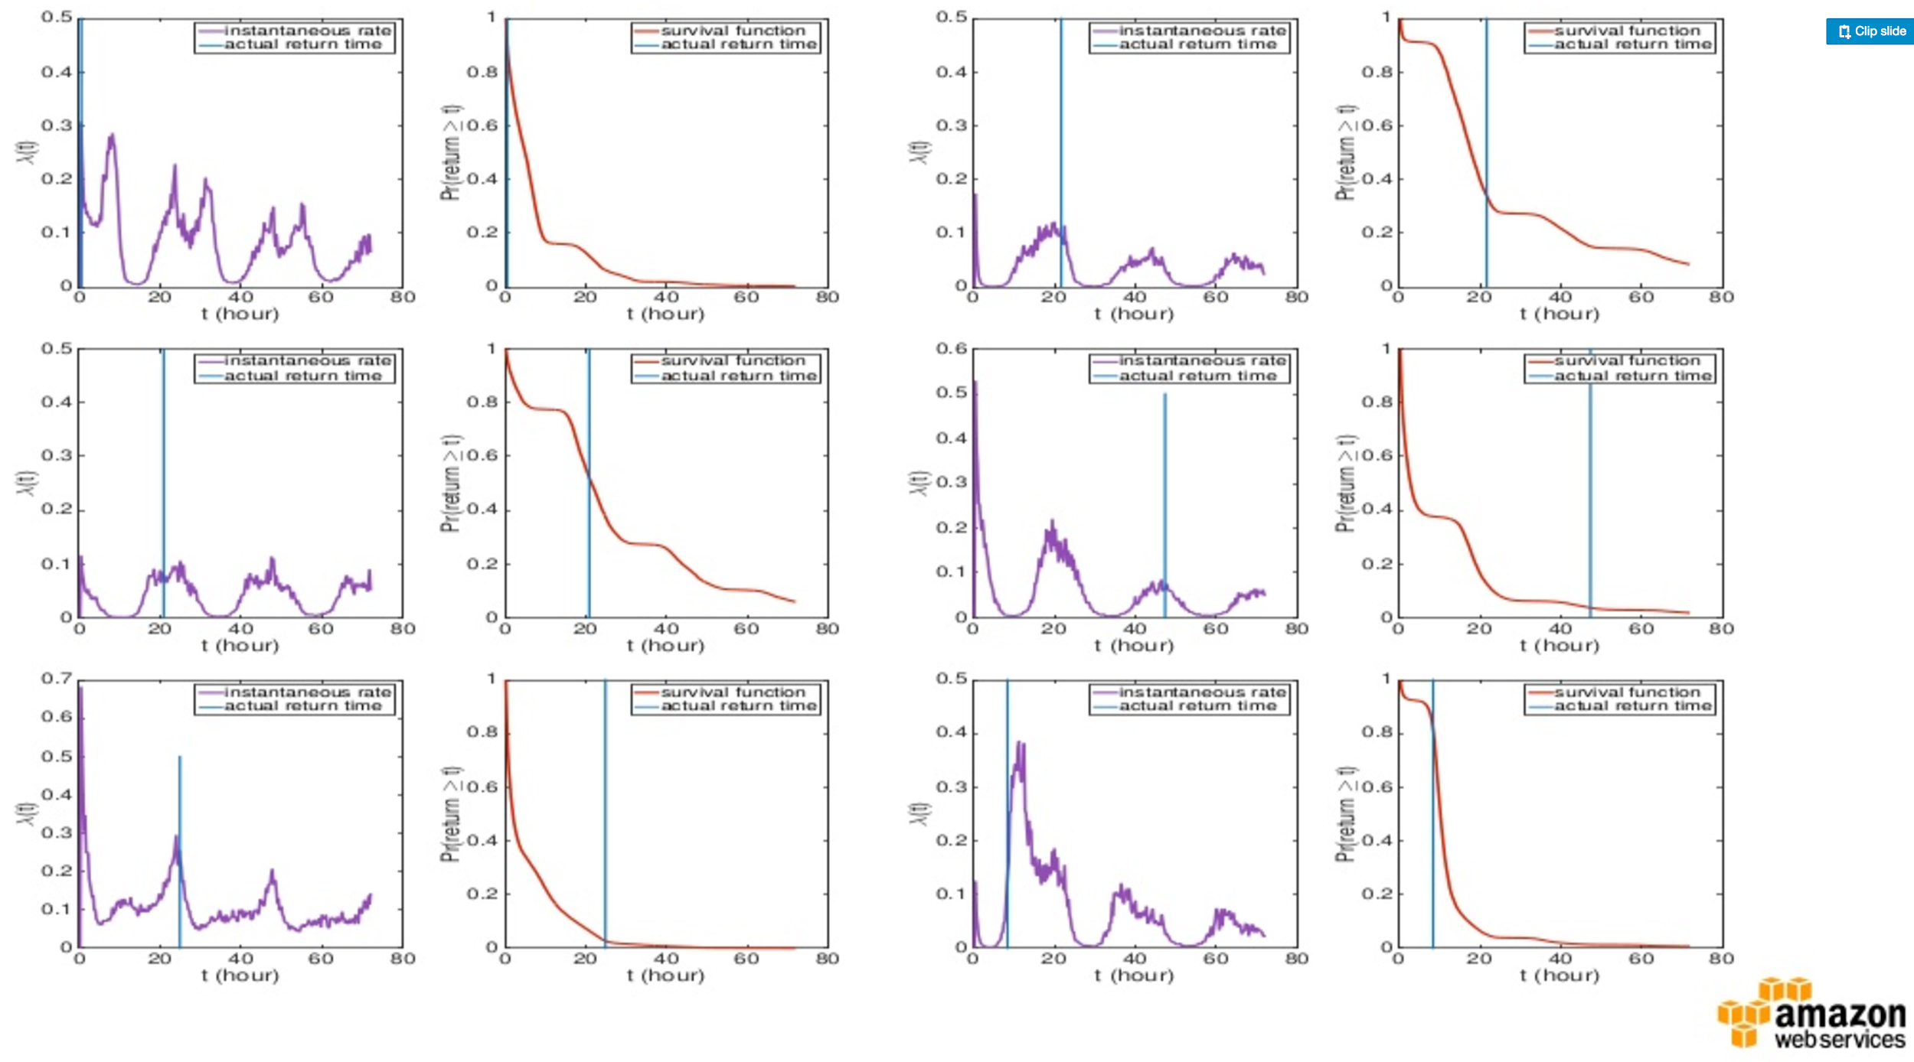
Survival Plots for individual users

Slide 68
More fun with pandas
Pandas can do sql-like operations, and aggregations

Slide 69
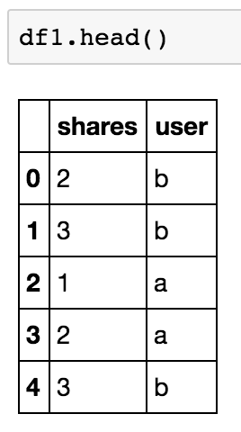
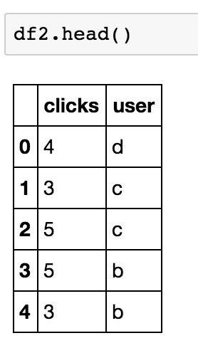
A couple of toy data sets: fake session data
Are shares and clicks correlated?
Need to:
Aggregate each user’s events
Join the data sets
Measure the correlations

Slide 70
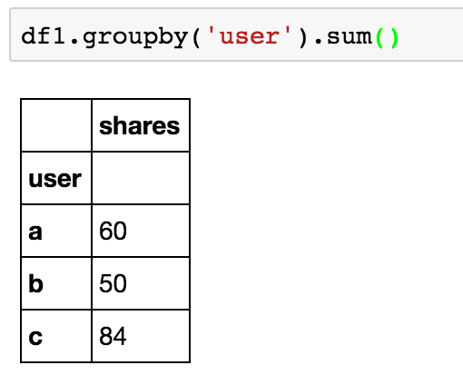
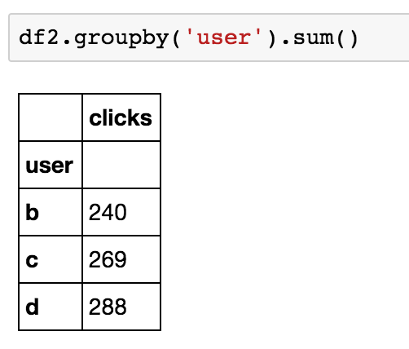
Aggregate

Slide 71
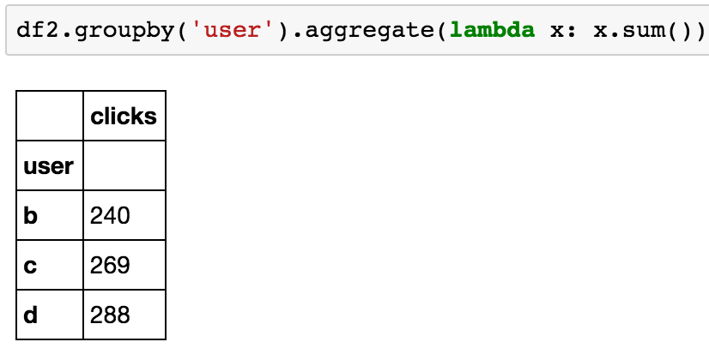
(can also define custom aggregations)

Slide 72
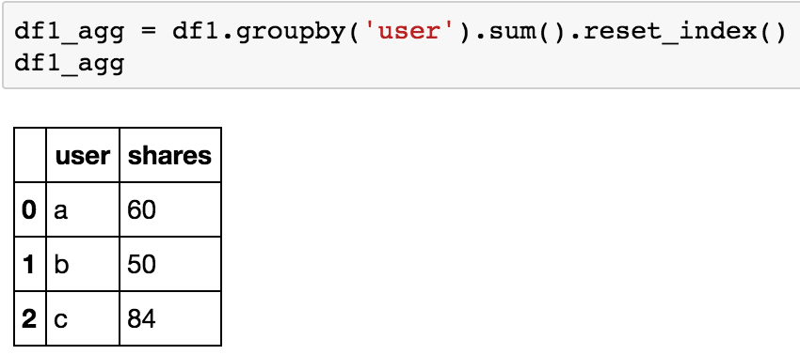
Reset the index before merging

Slide 73
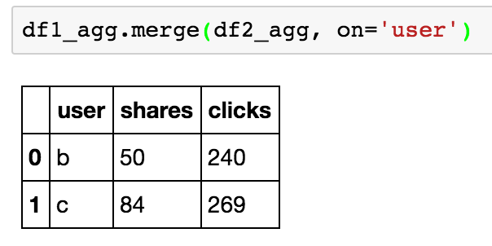
The result:

Slide 74
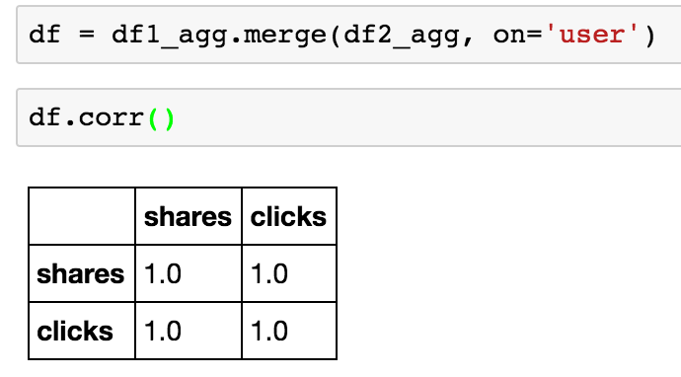
We have too little data for a good correlation… but it’s easy to measure!

Slide 75
Summary
Raw data alone is valuable (rank it; look at extreme values)
Statistics of data aids decision making
Rates and Totals are common
Calculate error bars for rates! If totals are of a sample, calculate error bars too! Bootstrapping is a great tool.
Which statistic to use is a hard decision
Consider estimation noise as a function of rate for rate statistics
Rates can increase farther down a “funnel,” but sample size decreases. Figure out which “wins” empirically.
Pandas is great for this kind of analysis.

Slide 76
More fun with Pandas: Exercise
Download the data set from https://data.cityofnewyork.us/City-Government/Expense-Budget/mwzb-yiwb
Load it into a jupyter notebook with pandas
Find the total budget by department
Restrict and sort the data to check if the error from the blog post is gone!

